Slide 1
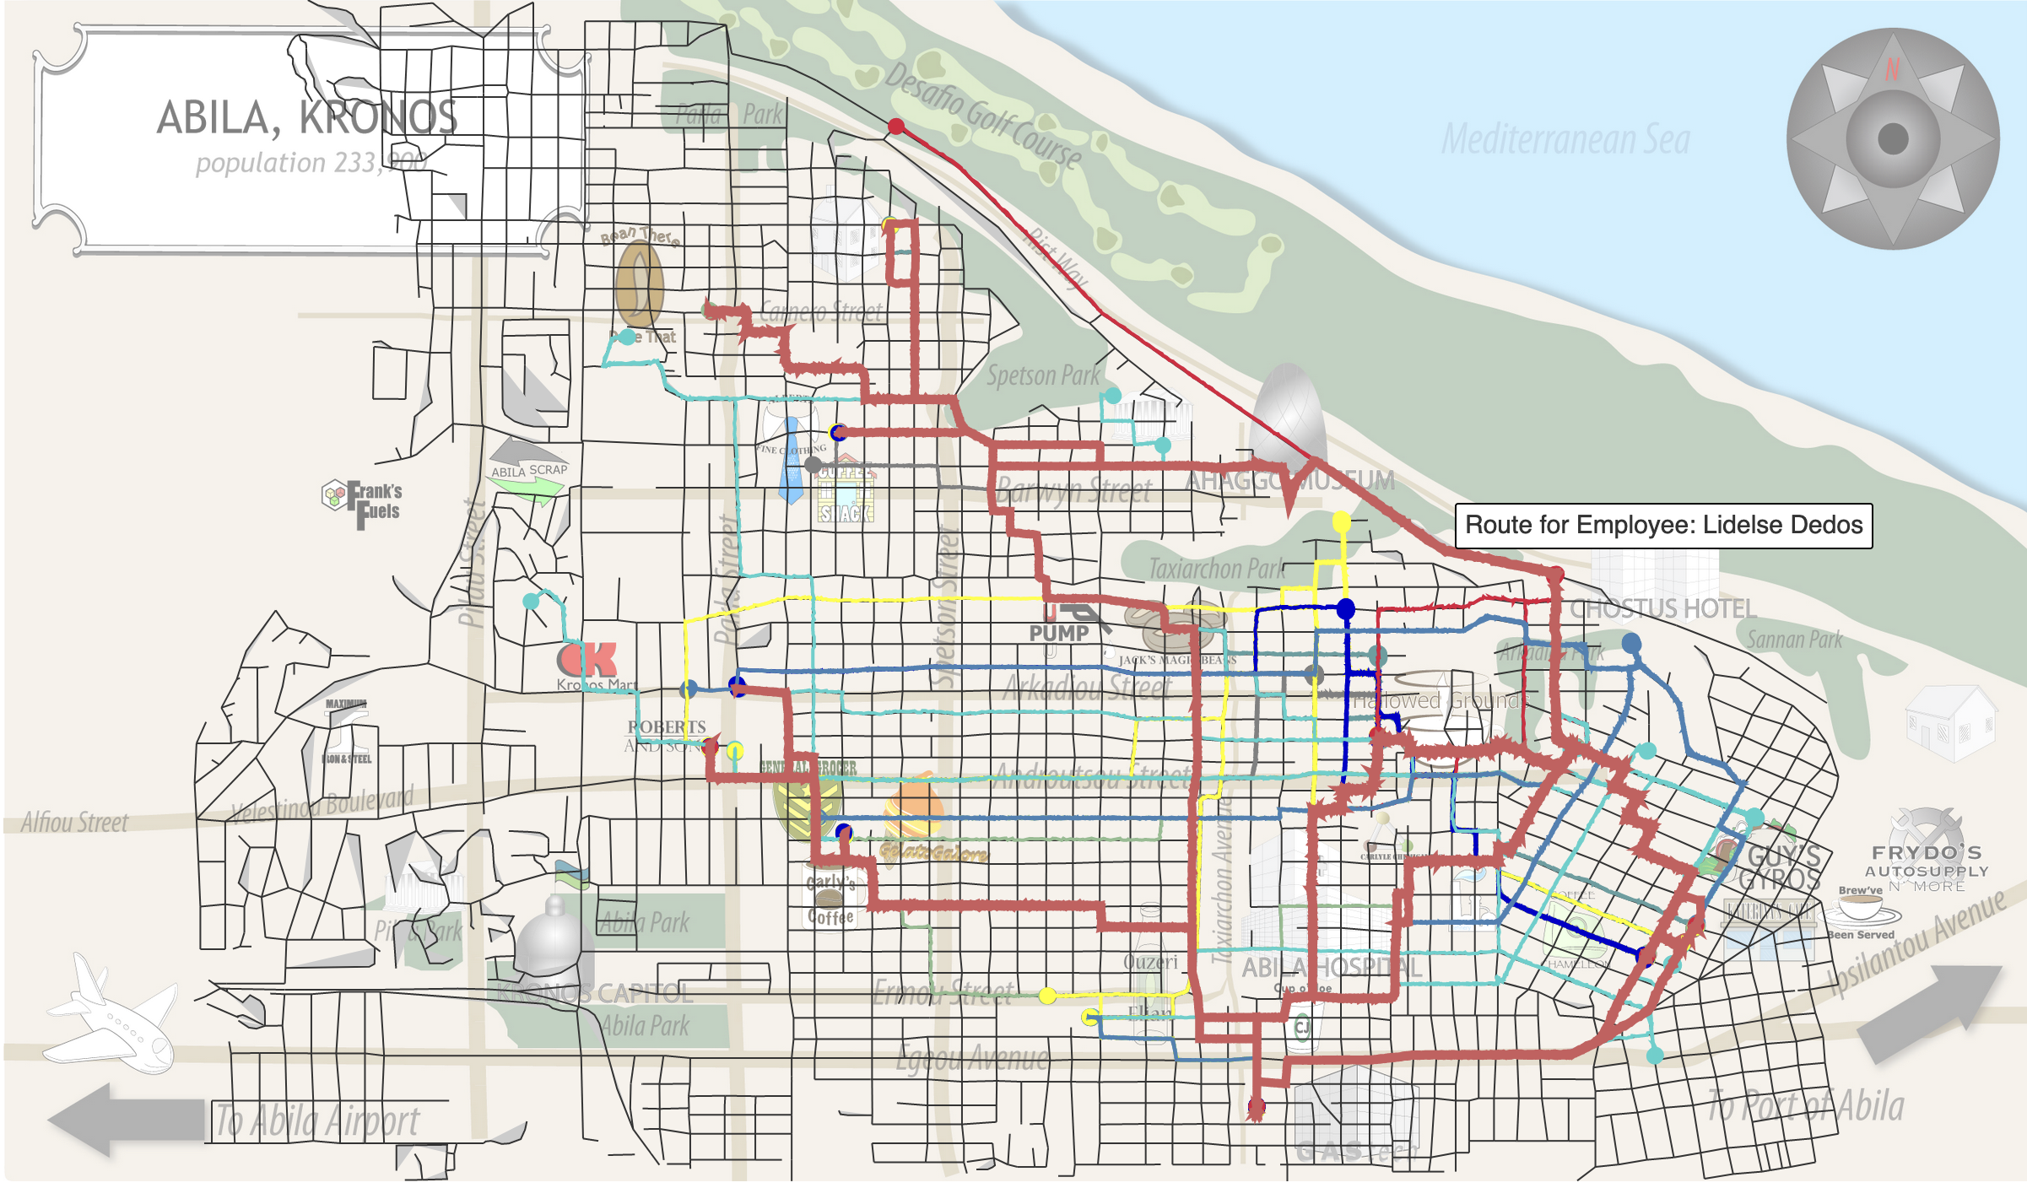
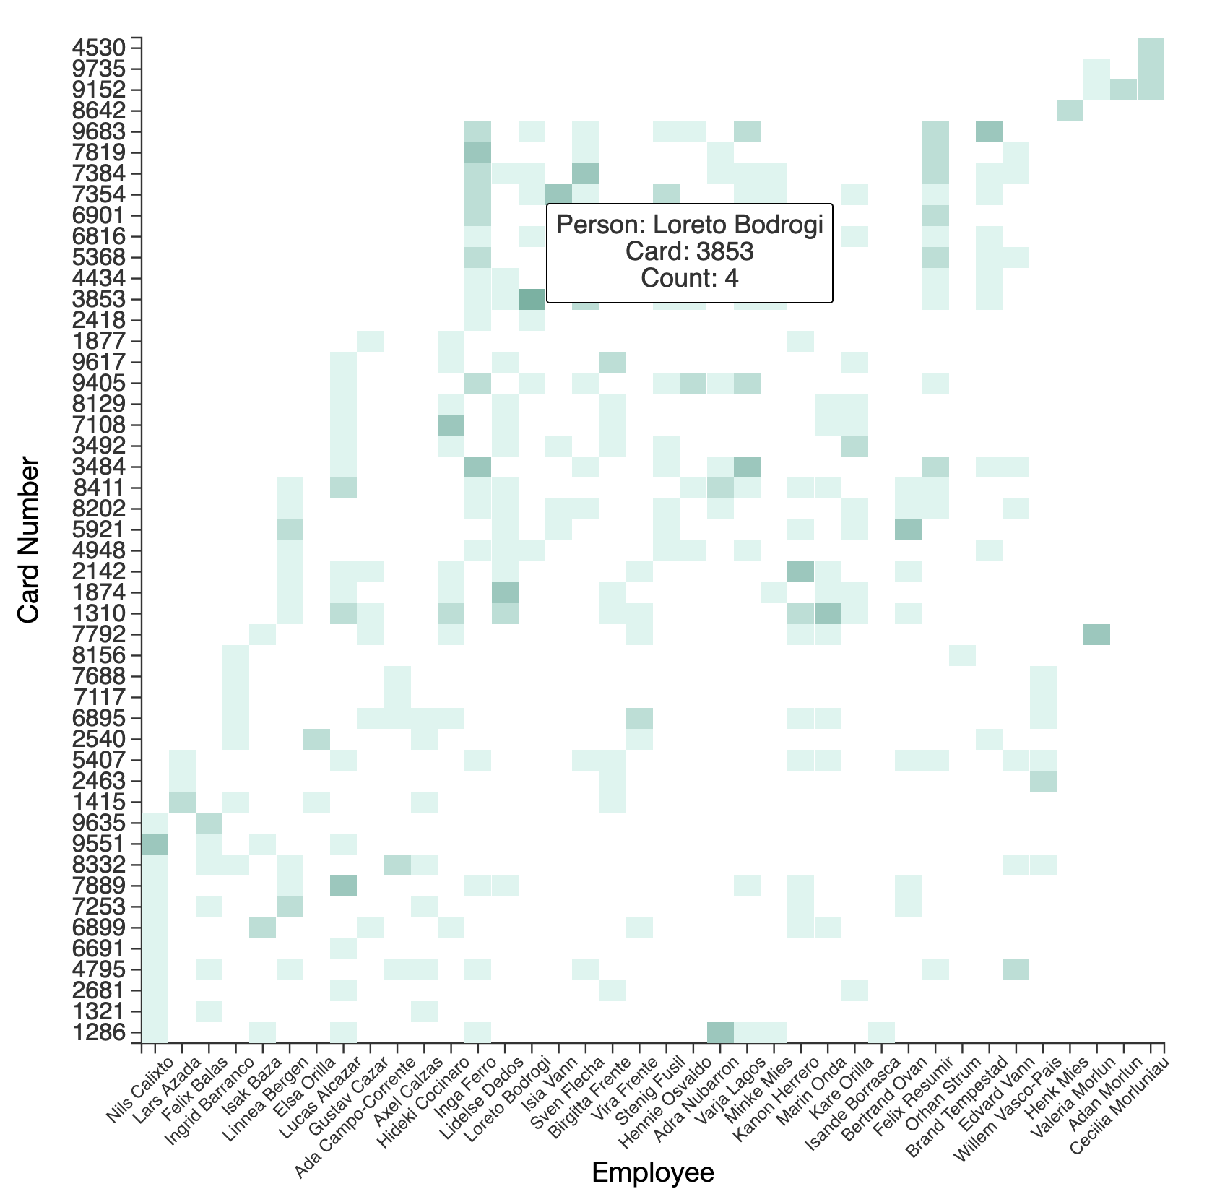
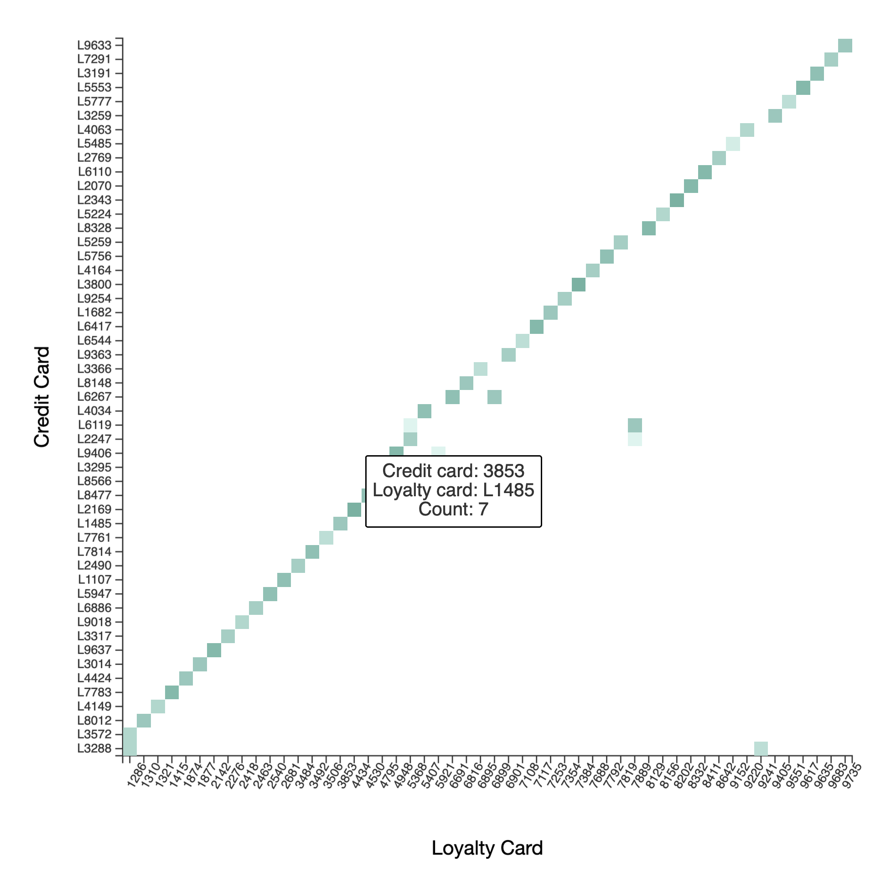
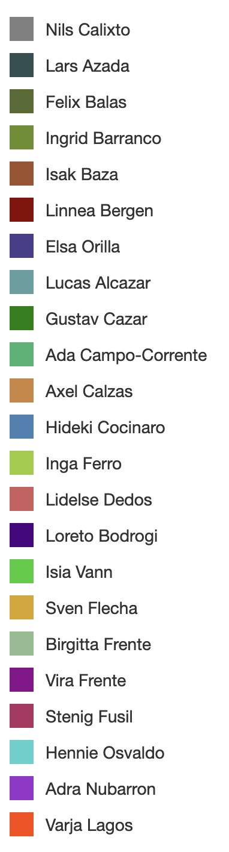
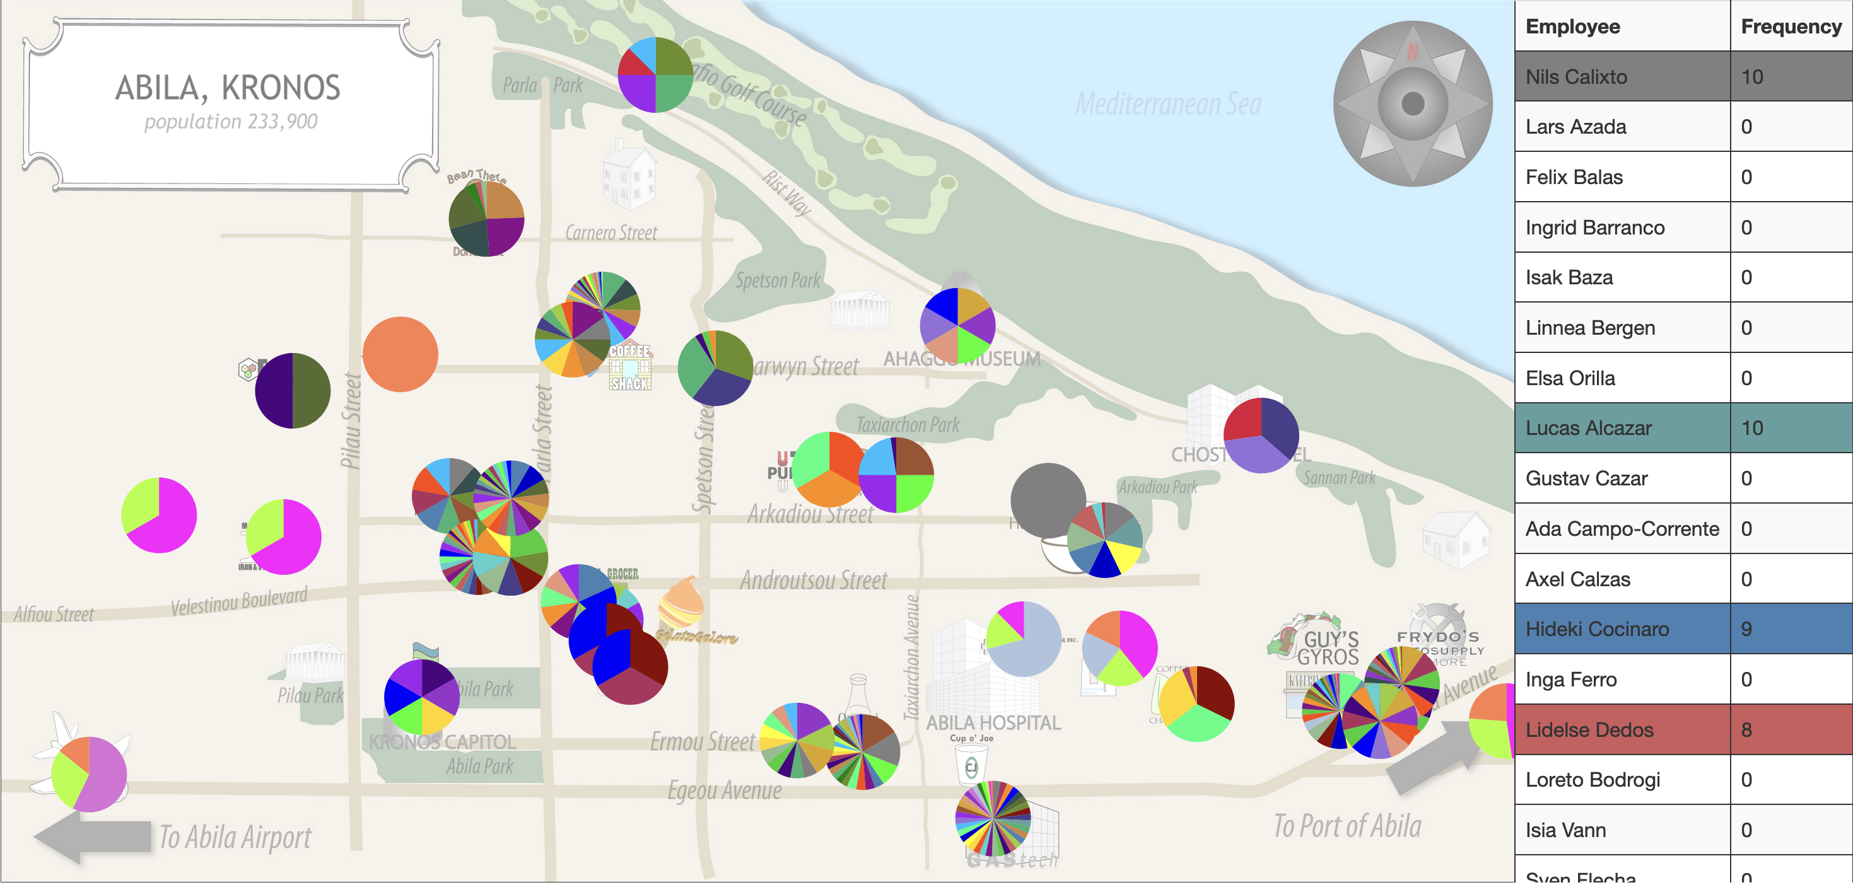
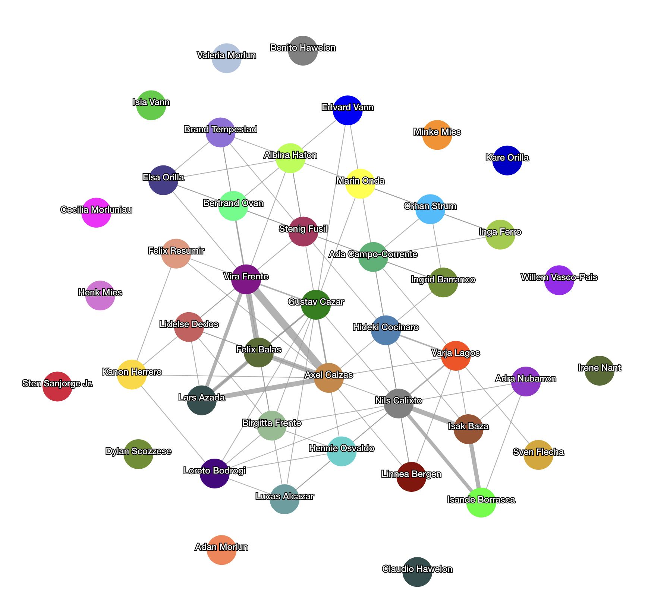
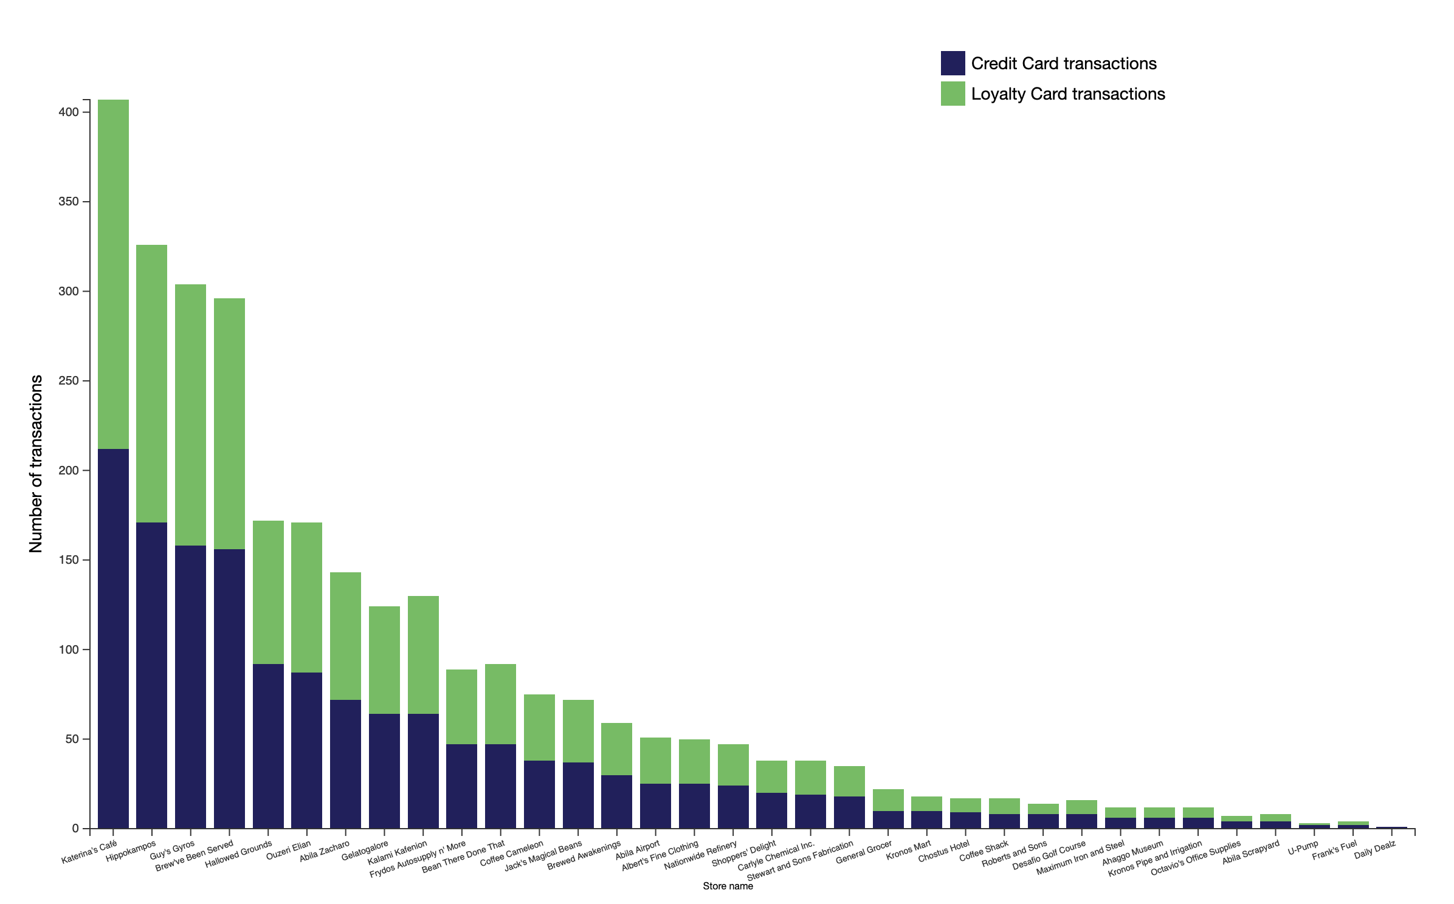
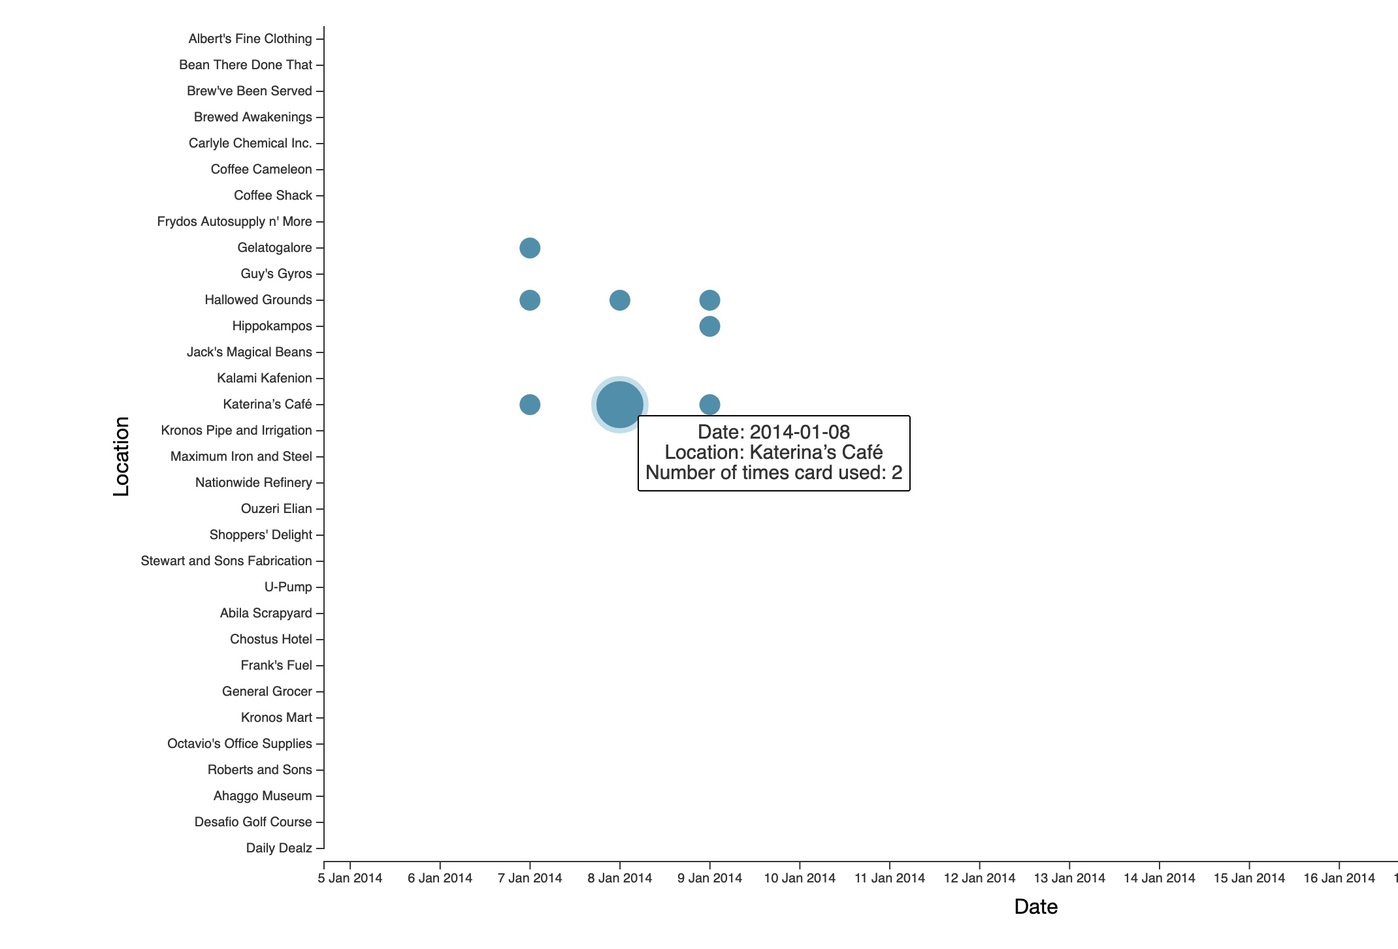
Identification of Suspicious Behaviors Among GAStech Employees Using Visual Analytics
Introduction
Visual analytics system with seven visualizations to identify suspicious behaviors in GAStech employee disappearance case, using movement data, credit card transactions, and loyalty card usage.
System Description
Visualizations include stacked bar chart, map of vehicle routes, heat maps for people/card associations, bubble chart for transaction frequency, node-link diagram for relationships, and symbol map with pie chart marks.
Datasets:
Four tabular datasets provided: car-assignments.csv (vehicle assignments), gps.csv (vehicle tracking data), loyalty_data.csv (loyalty card transactions), and cc_data.csv (credit/debit card transactions).
Datasets contain various attributes such as timestamps, locations, prices, employee details, latitude/longitude coordinates, and card numbers.
Results:
Identified key suspicious behaviors and patterns among GAStech employees using visual analytics tools.
Uncovered associations between people, locations, and transaction data, revealing possible connections to the disappearances.
Detected anomalies in movement and card usage data that could provide valuable leads for further investigation.
Jiahui Li, Deval Pandya, Malin Tan, Himanshu Sharma, Chen-Ni Lin, Pengfei Zhang
{jiahui12, djpandya, mtan12, hsharm39, clin250, pzhang84}@asu.edu

